Slide 1


MVSR Engineering College, Hyderabad - 501 510
Bachelor of Engineering
Department of Computer Science and Engineering
Project Name: Time Series Forecasting on Covid-19 Data with Parametric Curve Fitting
Batch No: A18
Sushma Salunke – 2451-17-733-010
Kunapareddy Jyothirmayee – 2451-17-733-050
Karnati Chaitanya – 2451-17-733-051
Under the guidance of
Mrs.K.V.SriLakshmi
Assistant Professor,
CSED,MVSREC

Slide 2
Batch No: A18 Name of the project: Time Series Forecasting on Covid-19 Data with Parametric Curve Fitting
Problem Statement:
All of us are aware of the 2019-nCoV (Corona virus) outbreak and how deadly it has turned out to be. The World Health Organization is currently monitoring the situation closely and working towards developing a Global Strategic Preparedness. Every day a situation report is published to track the number of Confirmed Cases, Deaths, Recoveries, New Cases and so on. Limited medical facilities and mismanagement of resource allocation can lead to additional severe cases and a decline in recovery rates.
Project Scope:
This system forecasts thus can also be of great help for the authorities to take timely actions and make decisions to contain the COVID-19 crisis. This system will be enhanced continuously in the future, next we plan to explore the prediction methodology using the updated dataset and use the most accurate and appropriate ML and deep learning methods for forecasting. It can be used in health sectors like Hospitals and Labs.
Application Areas:
Healthcare
Weather Forecasting
Stock Market Prediction
Challenges:
The first challenge is to have the time series dataset
And then to analyze the pattern of dataset
Integration of model with flask is a bit challenging.
In-house Project
Organization Name: Maturi Venkata Subba Rao Engineering College

Slide 3
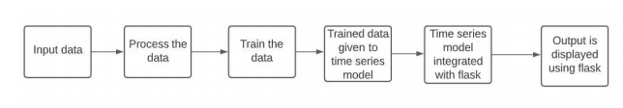
Batch No: A18 Name of the project: Time Series Forecasting on Covid-19 Data with Parametric Curve Fitting
Software Requirements:
Programming Language: Python
Jupyter Notebook,Postman
Hardware Requirements:
Operating System – Windows
Processor Intel i3 and above
RAM:4GB and higher
Project Objective:
The main objective of this project is to provide an early forecast model for the spread of novel coronavirus, also known as SARS-CoV-2.To predict the confirmed cases , new cases and total cases with parametric curve fitting.
System Architecture

Slide 4
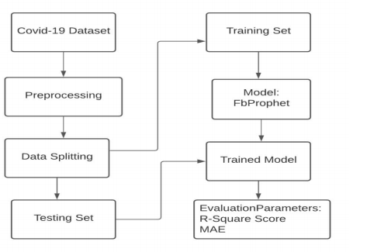
Batch No: A18 Name of the project: Time Series Forecasting on Covid-19 Data with Parametric Curve Fitting
Module-1 : Training and Testing the model
Description:
Give the dataset as the input and perform preprocessing then we split the data into training and testing sets. Evaluate the model on the test set.
Inputs: dataset consisting of some attributes
Outputs: values of evaluation parameters

Slide 5
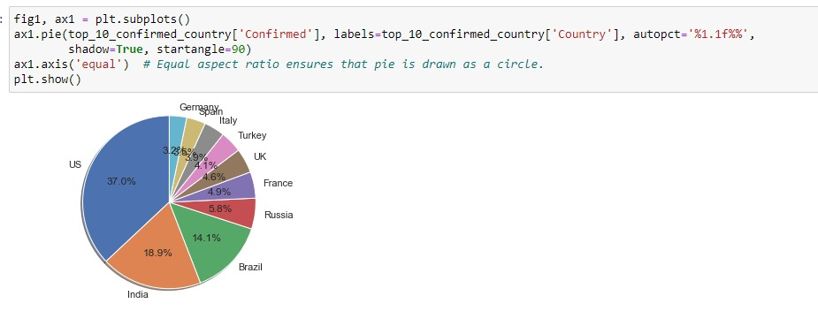
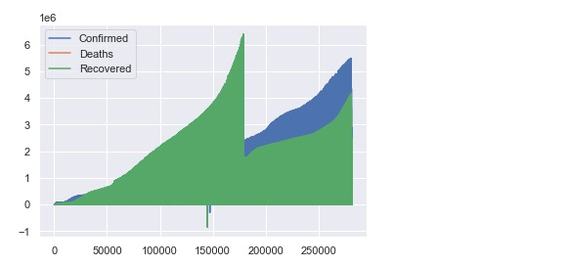
Batch No: A18 Name of the project: Time Series Forecasting on Covid-19 Data with Parametric Curve Fitting
Implementation of Module-1
Software Environment Used : Jupyter Notebook
Major Functions used : Prophet
Number of lines of code : 76
Test cases for Module 1:
Test case 1:
Input: Dataset
Output :

Slide 6
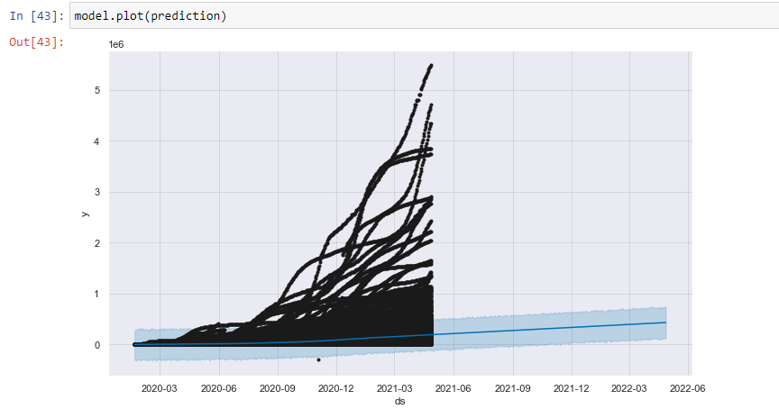
Batch No: A18 Name of the project: Time Series Forecasting on Covid-19 Data with Parametric Curve Fitting
Implementation of Module-1
Software Environment Used : Jupyter Notebook
Major Functions used : Prophet
Number of lines of code : 76
Test cases for Module 1:
Test case 2:
Input: Dataset
Output :

Slide 7
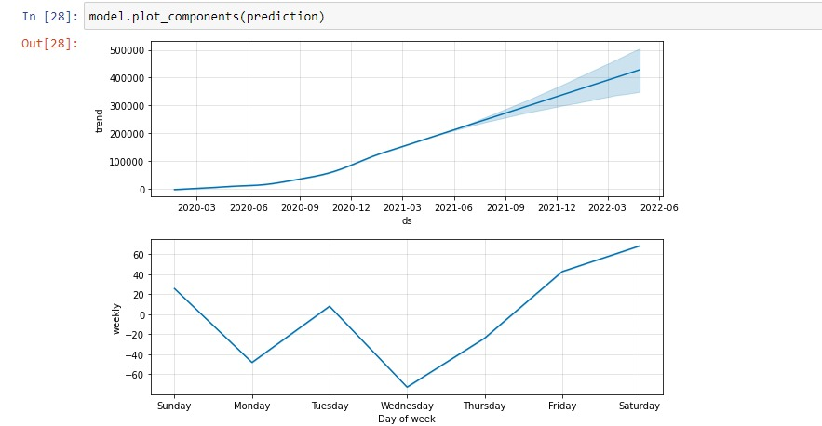
Batch No: A18 Name of the project: Time Series Forecasting on Covid-19 Data with Parametric Curve Fitting
Implementation of Module-1
Software Environment Used : Jupyter Notebook
Major Functions used : Prophet
Number of lines of code : 76
Test cases for Module 1:
Test case 3:
Input: Dataset
Output :

Slide 8
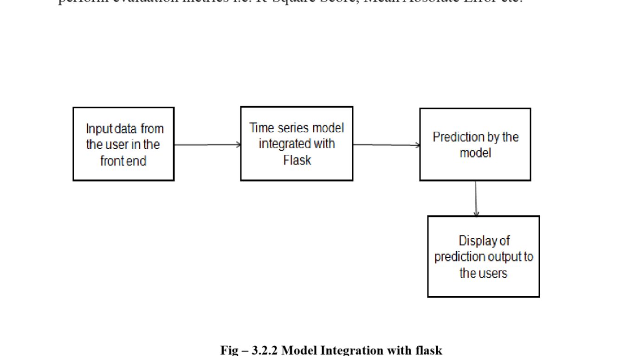
Batch No: A18 Name of the project: Time Series Forecasting on Covid-19 Data with Parametric Curve Fitting
Module-2: Integration with Flask
Description:
In this module i.e. model integration with flask we give the Input as the COVID-19 Dataset in the front end then the Time Series model (Fbprophet) is integrated with Flask.
Inputs: dataset
Outputs: forecast data

Slide 9
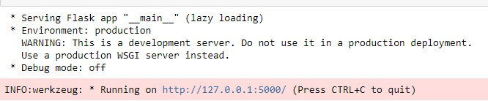
Batch No: A18 Name of the project: Time Series Forecasting on Covid-19 Data with Parametric Curve Fitting
Implementation of Module-2
Software Environment Used : Jupyter Notebook
Major Functions used : Flask, predict
Number of lines of code : 20
Test cases for Module 2:
Test case 1:
Input : Prophet model
Output :

Slide 10
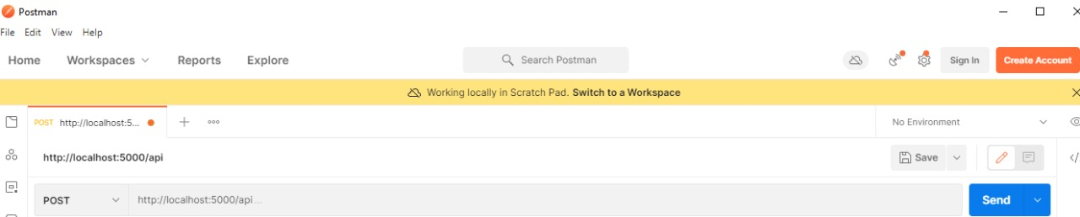
Batch No: A18 Name of the project: Time Series Forecasting on Covid-19 Data with Parametric Curve Fitting
Implementation of Module-2
Software Environment Used : Jupyter Notebook
Major Functions used : Flask, predict
Number of lines of code : 20
Test cases for Module 2:
Test case 2 :
Input : Prophet model
Output :

Slide 11
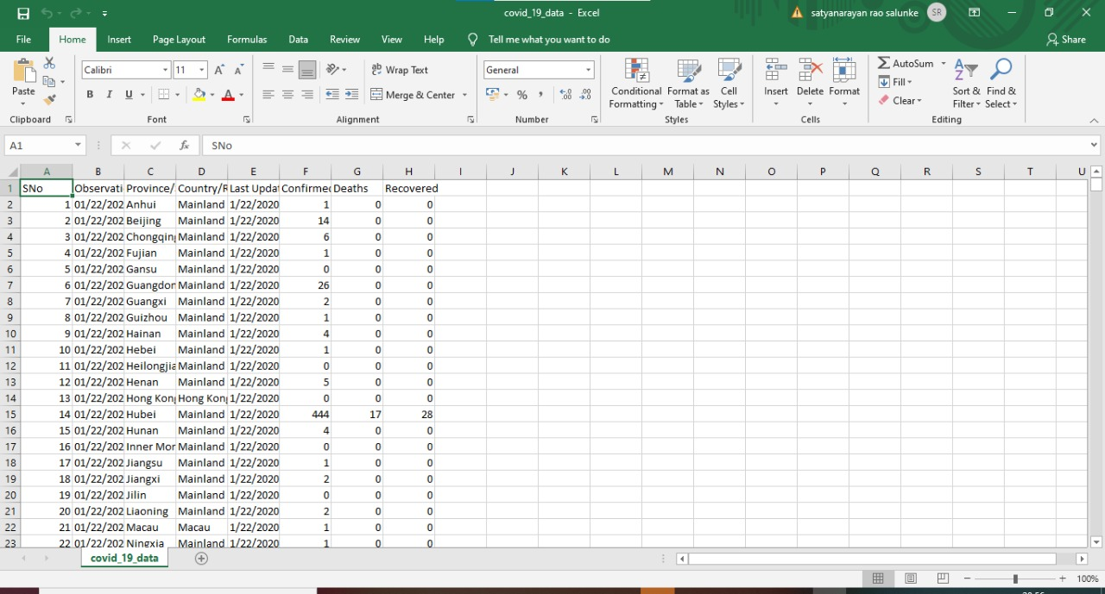
Batch No: A18 Name of the project: Time Series Forecasting on Covid-19 Data with Parametric Curve Fitting
Evaluation Criteria
Dataset Employed
Our dataset consists of 8columns and 236018rows of different countries all over the world.

Slide 12
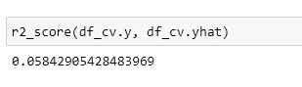


Batch No: A18 Name of the project: Time Series Forecasting on Covid-19 Data with Parametric Curve Fitting
Evaluation Criteria
Evaluation Metrics:
Root Mean Squared Error (RMSE):
Represents the sample standard deviation of the differences between predicted values and observed values.
Mean Absolute Error (MAE) :
Takes the sum of the absolute difference from actual to forecast and averages them.
Mean Squared Error (MSE):
It is calculated as the average of the squared forecast error values.

Slide 13
Batch No: A18 Name of the project: Time Series Forecasting on Covid-19 Data with Parametric Curve Fitting
Integration & Deployment
Technical challenges faced / Issues addressed
As we are using time series forecasting if the dataset used was seasonal then we could get the best results but as the dataset taken was covid19 which was not a seasonal dataset.
Deployment of FB prophet with flask is also one of the issue.
After running the flask when we get the URL as output and then when the URL is clicked we got the Internal Server Error which was the difficult challenge faced.

Slide 14
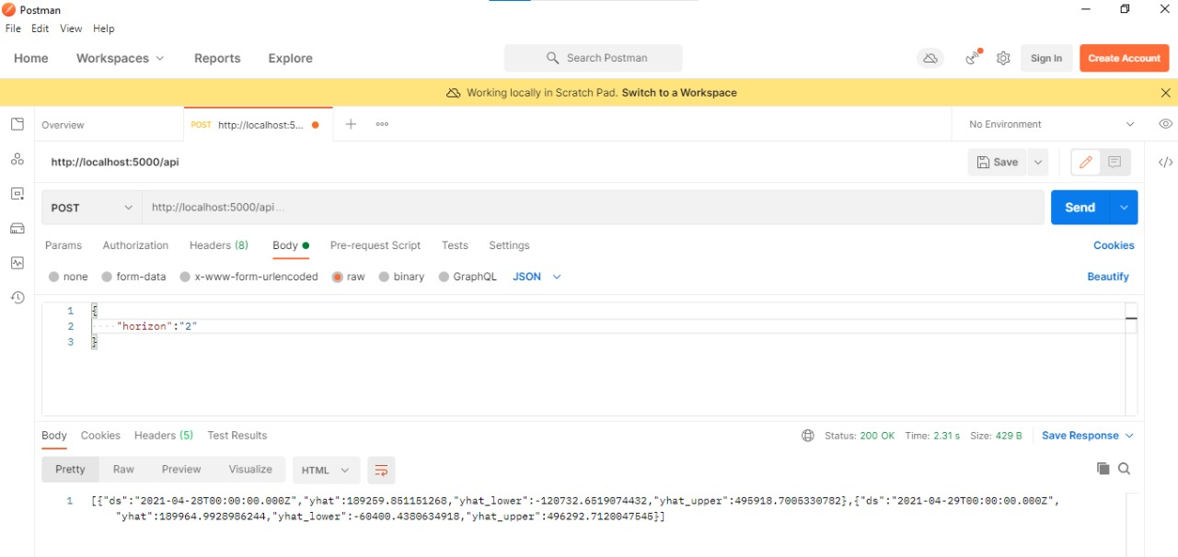
Batch No: A18 Name of the project: Time Series Forecasting on Covid-19 Data with Parametric Curve Fitting
Results

Slide 15
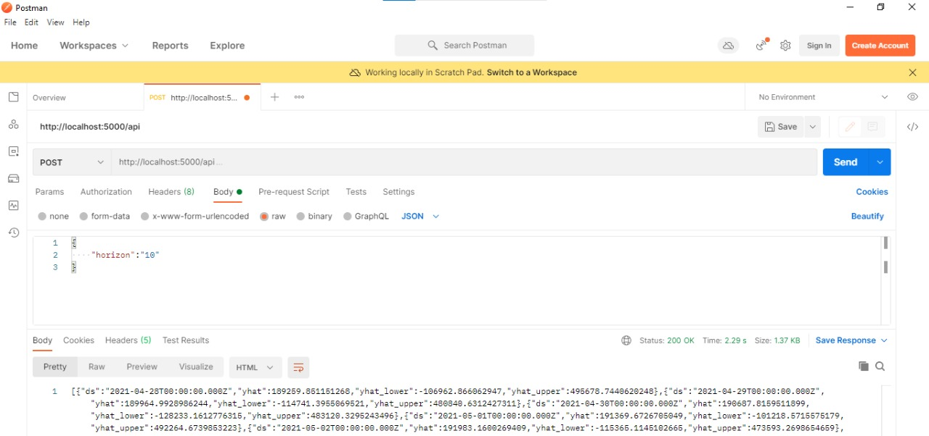
Batch No: A18 Name of the project: Time Series Forecasting on Covid-19 Data with Parametric Curve Fitting
Results

Slide 16
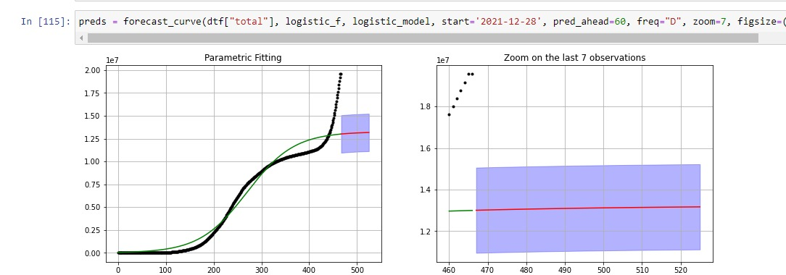
Batch No: A18 Name of the project: Time Series Forecasting on Covid-19 Data with Parametric Curve Fitting
Results

Slide 17
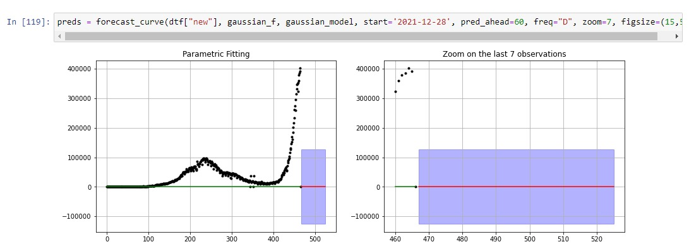
Batch No: A18 Name of the project: Time Series Forecasting on Covid-19 Data with Parametric Curve Fitting
Results

Slide 18
Batch No: A18 Name of the project: Time Series Forecasting on Covid-19 Data with Parametric Curve Fitting
Conclusion & Future scope
Conclusion:
In this project, we have proposed a Time Series model using FbProphet on covid19 dataset to predict number of confirmed cases in future and even we have shown a parametric curve on the time series dataset. At present we have deployed our model using flask through REST API in Postman where prediction horizon parameter is passed to the API and we get back JSON response with forecast data.
Future Scope:
The future scope of this project is to forecast for a minute and hourly forecasts also using PROPHET, which are the components not available also it should be ensuring to create computerized calculations to provide information within a standard range and naturally predict the number of cases daily and every week.

Slide 19
Batch No: A18 Name of the project: Time Series Forecasting on Covid-19 Data with Parametric Curve Fitting
References
[1] G.E. Box, D.A. Pierce, Distribution of residual autocorrelations in autoregressive- integrated moving average time series models. J. Am. Stat. Assoc. 65(332), 1509– 1526 (1970).
[2] S. B. Lajevardi and B. Minaei-Bidgoli, "Combination of Time Series Decision Tree and Clustering : A Case Study in Aerology Event Prediction", International Conference on Computer and Electrical Engineering, pp. 111-115, 2008.
[3] Rasheed Omobolaji Alabi, Akpojoto Siemuri, and Mohammed Elmus-rati. Covid- 19: Easing the coronavirus lockdowns with caution. medRxiv,2020
[4] WHO. Laboratory Testing for Coronavirus Disease 2019 (COVID-19) in Suspected Human Cases: Interim Guidance, 2 March 2020; Technical report. WHO: Geneva, Switzerland, 2020.
[5] S. Mehrmolaei and M. R. Keyvanpour, "A Brief Survey on Event Prediction Methods in Time Series" in Artificial Intelligence Perspectives and Applications, Springer International Publishing, pp. 235-246, 2015.
[6] Lu, H.; Stratton, C.W.; Tang, Y.W. Outbreak of Pneumonia of Unknown Etiology in Wuhan China: The Mystery and the Miracle. J. Med Virol. 2020, 92, 401–402.

Slide 20
Batch No: A18 Name of the project: Time Series Forecasting on Covid-19 Data with Parametric Curve Fitting
THANK YOU

